Slide 1

Investment advisor
Group Members:-
Ritesh Gandhare (PD14_066)
Ayush Saxena (PD15_033)
Mohit Verma (PD15_084)
Syed Zeeshan Alam (PD15_181)
This Photo by Unknown Author is licensed under CC BY-NC-ND

Slide 2

Outline
Introduction
Goals and Objective
Tools
Challenges
Important Codes
Insights
Dashboard

Slide 3
Introduction
A investment advisor is one who provides guidance on how, where, and when to invest. The advice they provide could be for a wholesome ﬁnancial plan or individual investments made towards a larger ﬁnancial plan.
The analysis of the access of Customer Income and Expenses and guide him throughout the particular challenges while guiding him to invest his money for a better future.

Slide 4
Goals and Objective
The first task is to Analyze the given data and understand the problem
The second task is to Manipulate and clean the data.
Based on the subtasks we apply the various aggregation to the data.
After that process we take out the insights of data from the customer’s chosen investment profile.
We have to visualize the data to make customers understand it properly.

Slide 5
Tools
Python
(Libraries – G-spread, PandasSQL, Pandas, Numpy)
Google Sheet
Excel

Slide 6
CHALLENGES
The very First challenge we faced is to make the connection with google Sheets to python.
The second challenge we faced to learn the g-spread python library.
The Third challenge that we faced was analyzing the data.
The Fourth challenge that we faced was filtering the data.
The fifth challenge that we faced was to connect all the datasets which are in the google sheet to the dashboard.

Slide 7
Important Codes
Connecting Service Account:-
gc = gspread.service_account(filename='service_account.json’)
Connecting G-spread to Python:-
credentials = Credentials.from_service_account_file( 'service_account.json', scopes=scopes
Key performance indicator is used to help define the best stock across deferent sectors:-
q1 = """ WITH CTE AS (SELECT * ,row_number() over (partition by Sector order by Price_to_Earnings) as rn FROM pe_kpi_stock_dataframe where Price_to_Earnings is not null) select * from CTE where rn == 1

Slide 8
Insights
Reliance company has the highest Market cap among the company’s shares.
Sanofi India ltd. Gives the highest dividend to shareholders.
The insurance sector has the highest median enterprise value.
No Relation between Dividend per share and market cap.
Best Companies Sector to Invest.

Slide 9
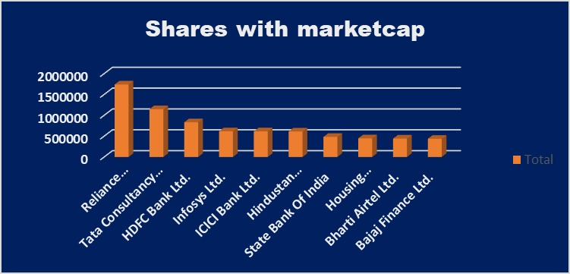
Reliance company has the highest Market cap among the company’s shares

Slide 10
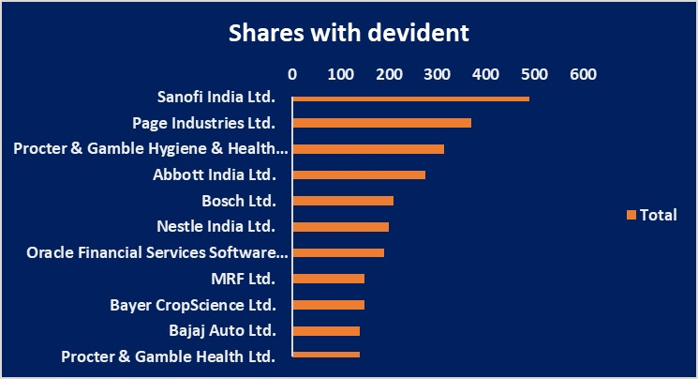
Sanofi India ltd. Gives the highest dividend to shareholders

Slide 11
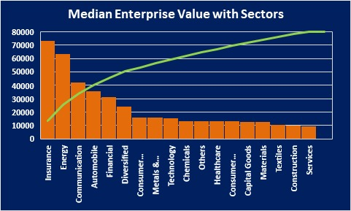
The insurance sector has the highest median enterprise value.

Slide 12
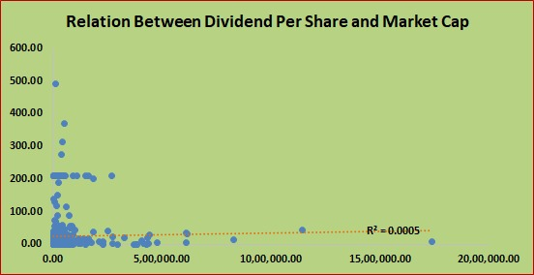
No Relation between Dividend per share and market cap

Slide 13
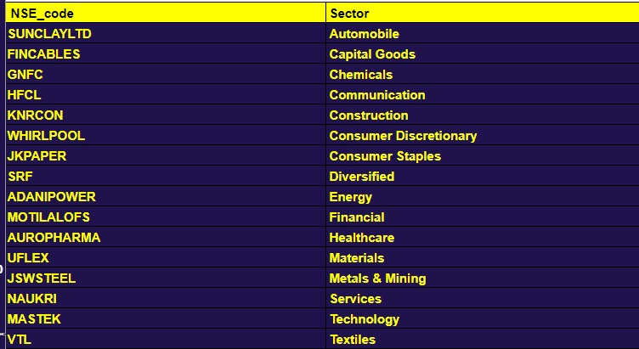
Best Companies Sector to Invest

Slide 14
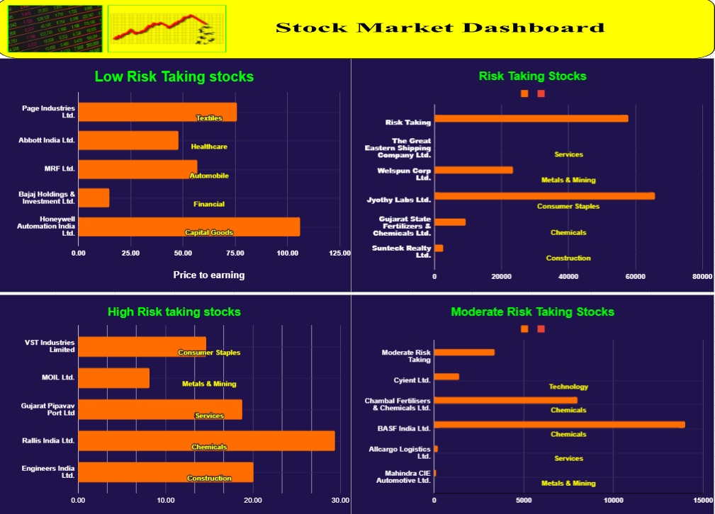
Dashboard

Slide 15

Thank you MASAI SCHOOL and team for providing us the opportunity to construct this project and for helping out when we faced challenges during the project.

Slide 16


This Photo by Unknown Author is licensed under CC BY-NC

